Slide 1


Data Analysis Using Python
Lecture:
Data Visualization
www.bennett.edu.in
Notes:
Add Caption : Expect More
1

Slide 2
What is Data Visualization?
Data visualization is a field in data analysis that deals with visual representation of data.
It graphically plots data and is an effective way to communicate inferences from data.
Using data visualization, we can get a visual summary of our data.
With pictures, maps and graphs, the human mind has an easier time processing and understanding any given data.
Data visualization plays a significant role in the representation of both small and large data sets, but it is especially useful when we have large data sets, in which it is impossible to see all of our data, let alone process and understand it manually.

Slide 3
Data Visualization in Python
Python offers several plotting libraries, namely Matplotlib, Seaborn and many other such data visualization packages with different features for creating informative, customized, and appealing plots to present data in the most simple and effective way.
Matplotlib and Seaborn are python libraries that are used for data visualization.
They have inbuilt modules for plotting different graphs. While Matplotlib is used to embed graphs into applications, Seaborn is primarily used for statistical graphs.

Slide 4
Visualization Goals
Answer Questions
Make decisions
See data in context
Support graphical calculations
Find patterns
Three functions of Visualization are:
Record: Store information
Analyse: Support reasoning about the information
Communicate: convey information to others

Slide 5
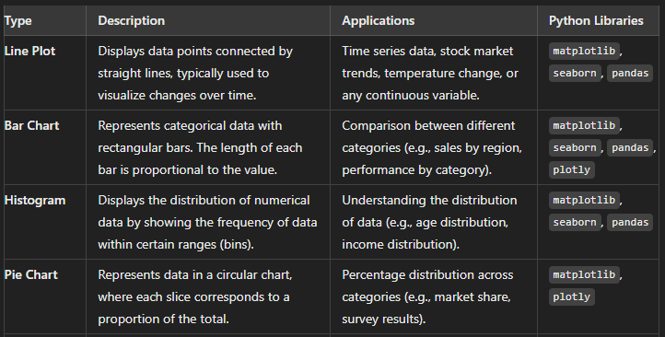
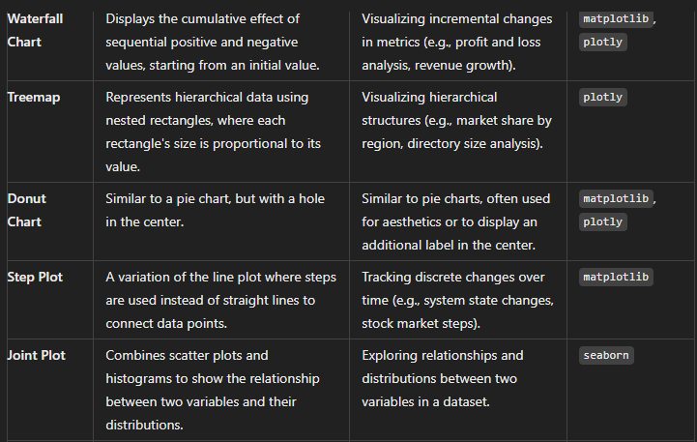
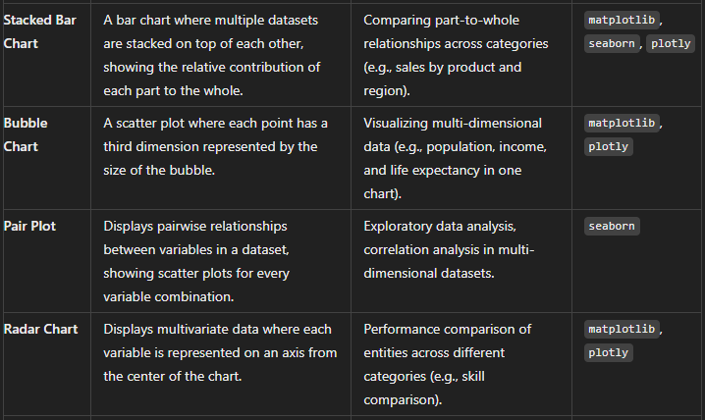
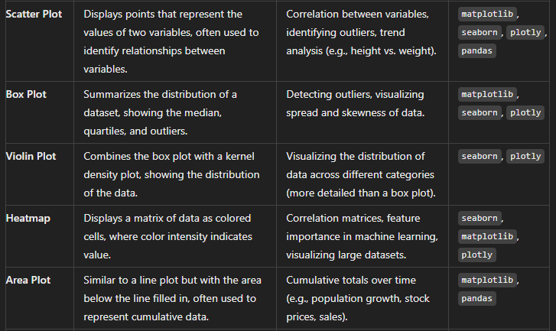
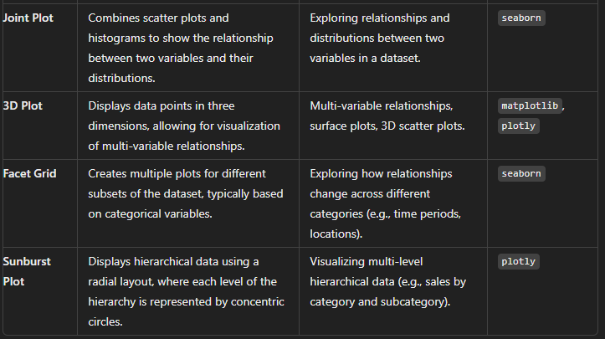

Slide 6
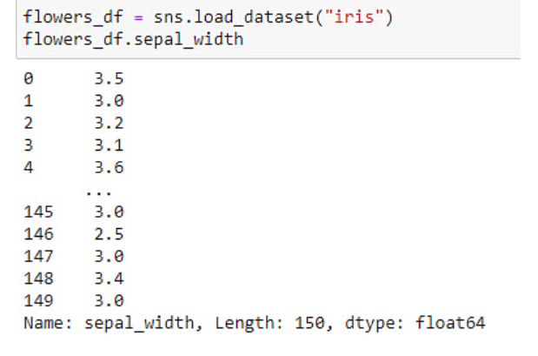
Histograms
A Histogram is a bar representation of data that varies over a range.
It plots the height of the data belonging to a range along the y-axis and the range along the x-axis.
Histograms are used to plot data over a range of values.
They use a bar representation to show the data belonging to each range.
Example: Let's use the ‘Iris’ data which contains information about flowers to plot histograms.

Slide 7
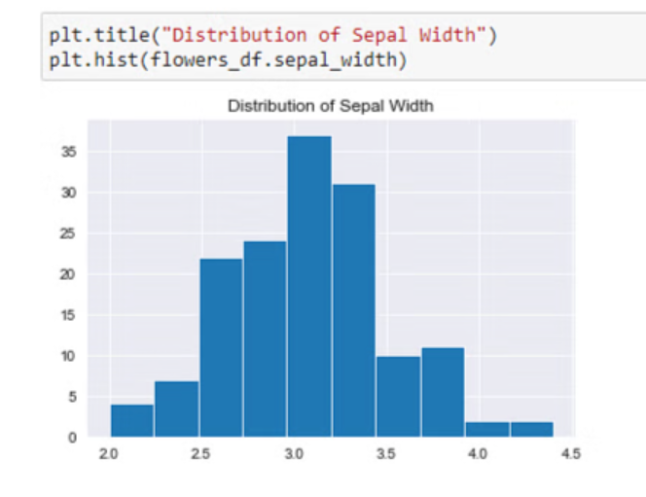
plot a histogram using the hist() function.

Slide 8
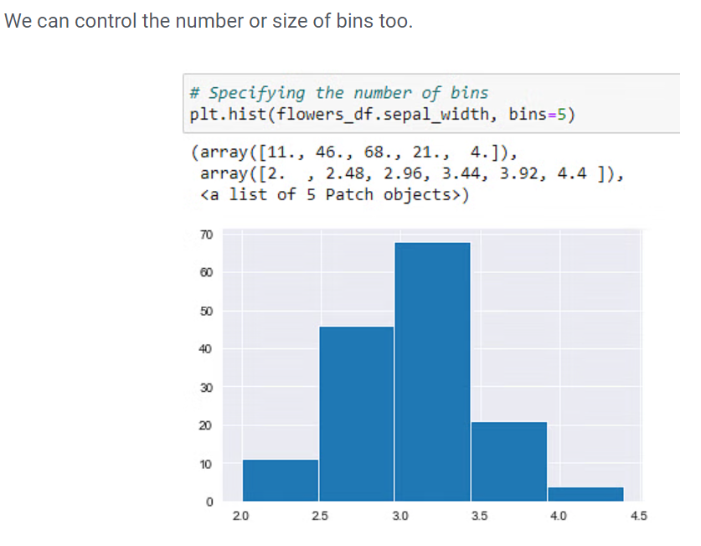

Slide 9
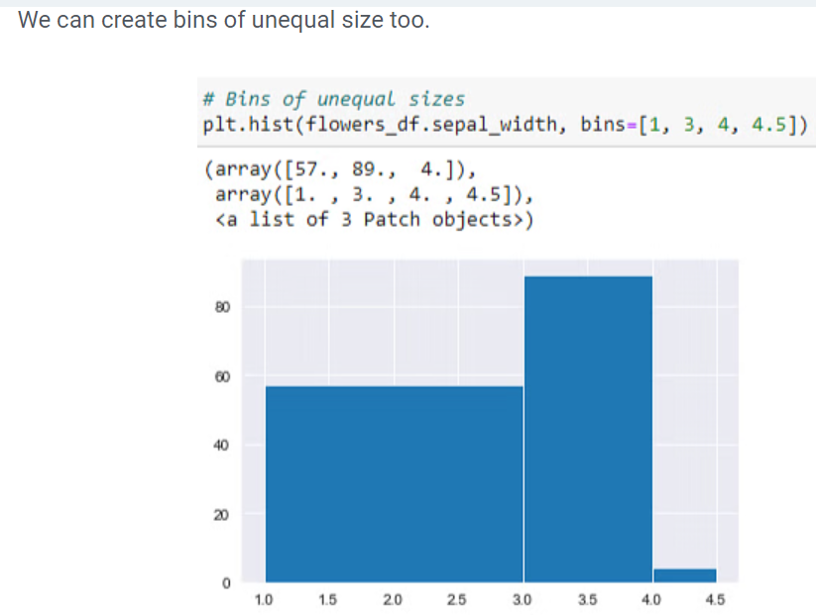

Slide 10
Python Seaborn Plotting Functions
Bar plot
Count plot
Distribution plot
Heatmap
Scatter plot
Pair plot
Linear Regression plot
Box plot

Slide 11
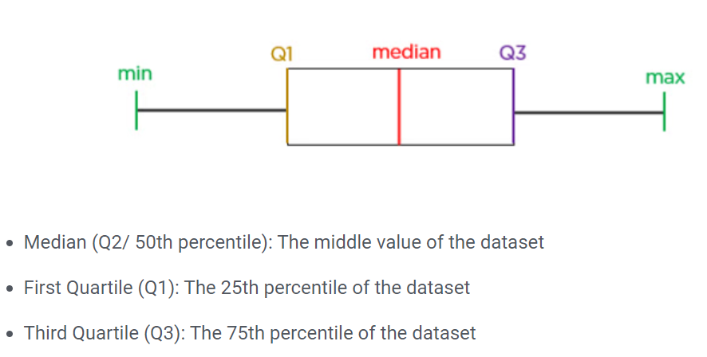
Box and Whisker Plot
They are graphical representations of variation in a set of data.
A histogram analysis is usually sufficient, but a box and plot can add more detail while also allowing multiple sets of data to be displayed in the same graph.

Slide 12
Why Use a Box and Whisker Plot?
The box and plot is used when:
You want to summarize the data from multiple sources and display the result in a single graph.
You can compare the data from different categories using box and whiskers plots, making the decision-making easier and more effective.
When to Use Box and Whisker Plot?
When you have multiple data sets from different sources that are related in some way, use boxes and plots. Here are some examples:
Test results from different schools or classrooms
Data from two identical machines producing the same goods
To make an accurate box and whiskers plot, you have to understand the five-number summary. The five-number summary is useful to identify and plot the points.

Slide 13
Five Number Summary
The method to develop a box and plot comes from the five statistics below.
Minimum value: It is the smallest value of the data set.
Second quartile: The value below which the lower 25% of the data are contained.
Median value: The middle number in a range of numbers.
Third quartile: The value above which the upper 25% of the data are contained.
Maximum value: It is the largest value in the data set.
Since you have an even number of age values, the median is the mean of (n/2) and (n/2 + 1)th observation.
15, 18, 19, 19, 20, 24, 25, 25, 27, 28

Slide 14
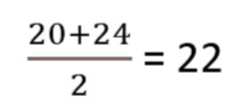
How to Create Box and Whisker Plot?
Now, you will understand the steps involved in making a box and plot.
Consider the following example:
The sample age of 10 students at a training center are given below:
15, 27, 19, 18, 24, 19, 20, 25, 25, 28
Step1: Order the data from smallest to largest.
15, 18, 19, 19, 20, 24, 25, 25, 27, 28
Step 2: Find the median.
Step 3: Find the quartiles.
The first quartile is the median of the age values to the left of the median.
15, 18, 19, 19, 20
Q1 = 19
The third quartile is the median of the age values to the right of the median.
24, 25, 25, 27, 28
Q3 = 25

Slide 15
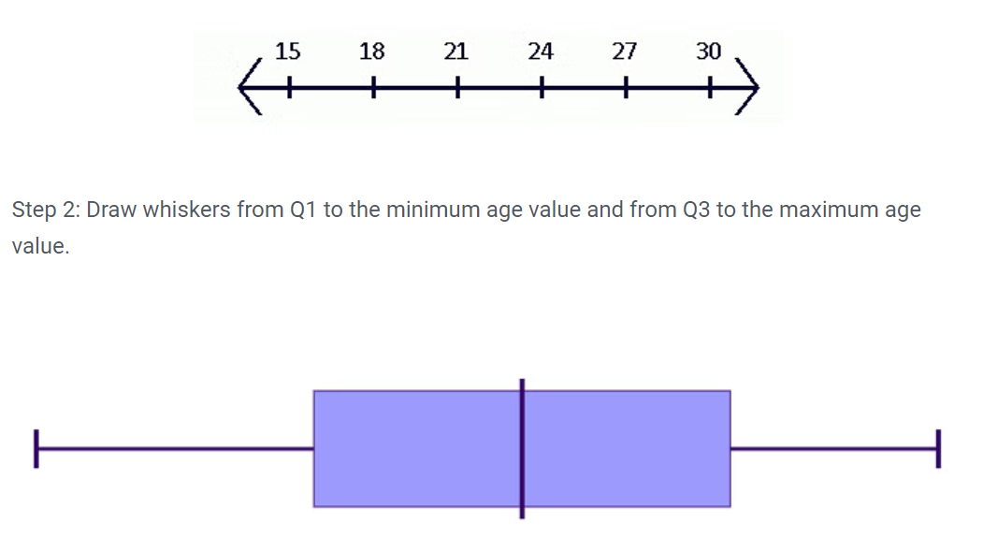
Step 4: Complete the five-number summary by finding the min and max values.
The min is the smallest age value, which is 15.
The max is the largest age value, which is 28.
The five-number summary is 15, 19, 22, 25, 28
Making a Box Plot
Step 1: Scale and label an axis that fits the five-number summary.

Slide 16
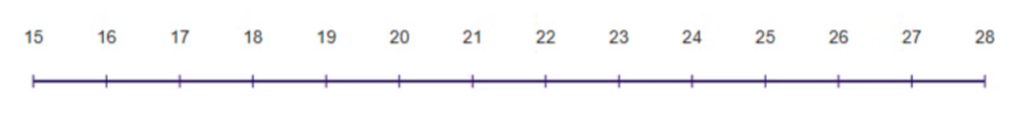
The resulting graph gives you the idea of the minimum, lower quartile, median, upper quartile, and maximum age value of the students in the dataset.
Below are the key points that you can draw from the above box and plot:
The lowest age among the students at the training center is 15 excluding outliers.
About 25% of students are under 19 years of age.
Close to 50% of the students are between 19 and 25 years of age.
Nearly 75% of students have an age less than 25.
The maximum age among the students is 28 excluding outliers.

Slide 17
Boxplot
A boxplot, also known as a box and whisker plot, depicts the distribution of quantitative data. The box represents the quartiles of the dataset. The whiskers show the rest of the distribution, except for the outlier points.
The boxplot below shows the distribution of the three species of iris flowers based on their sepal width.

Slide 18
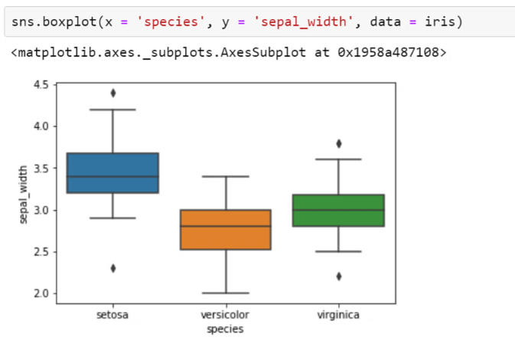

Slide 19
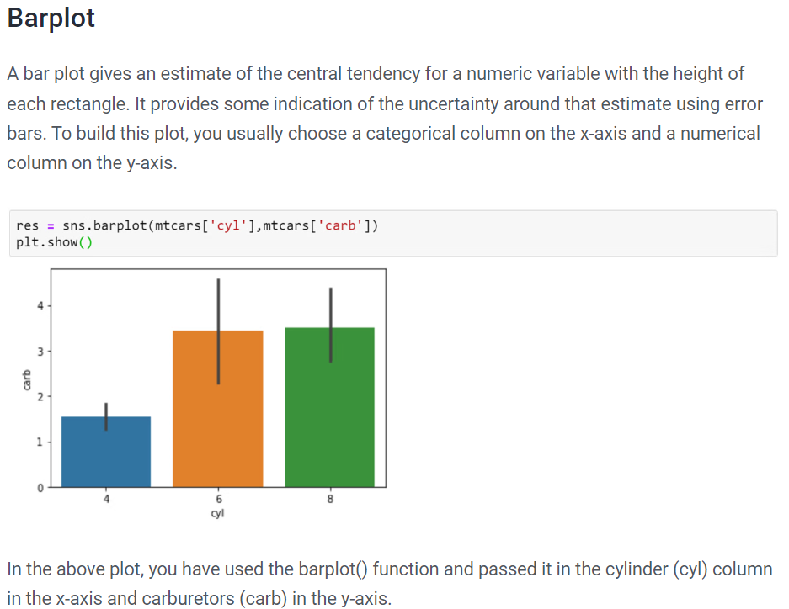

Slide 20
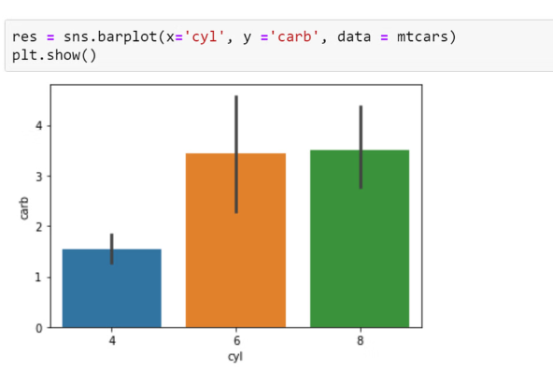
Another way

Slide 21
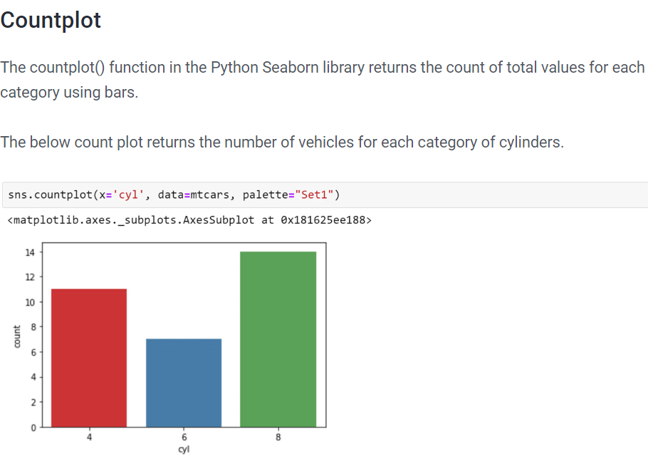

Slide 22
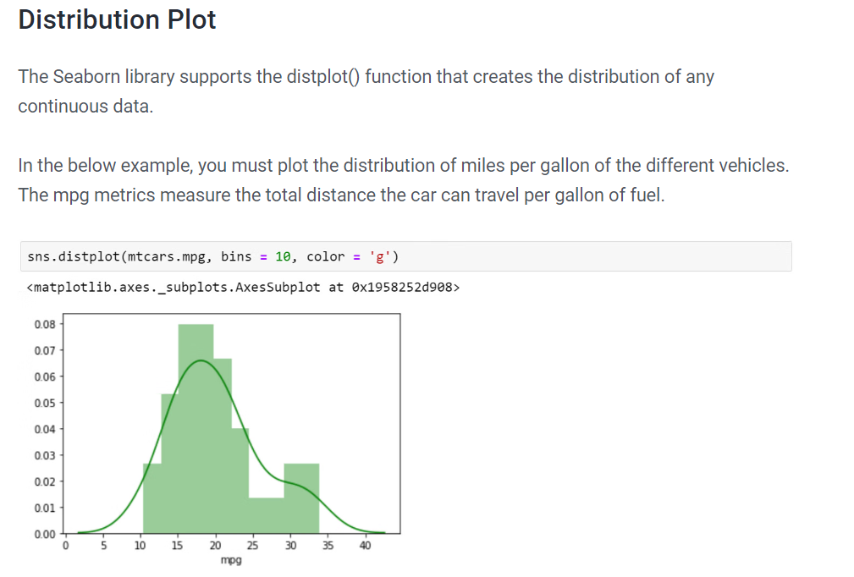

Slide 23
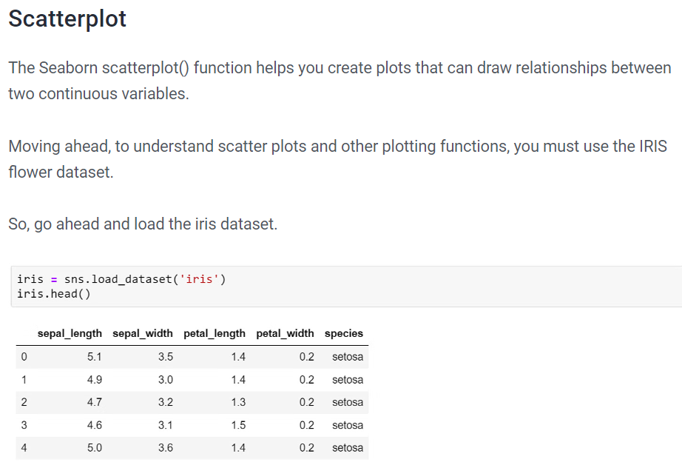

Slide 24
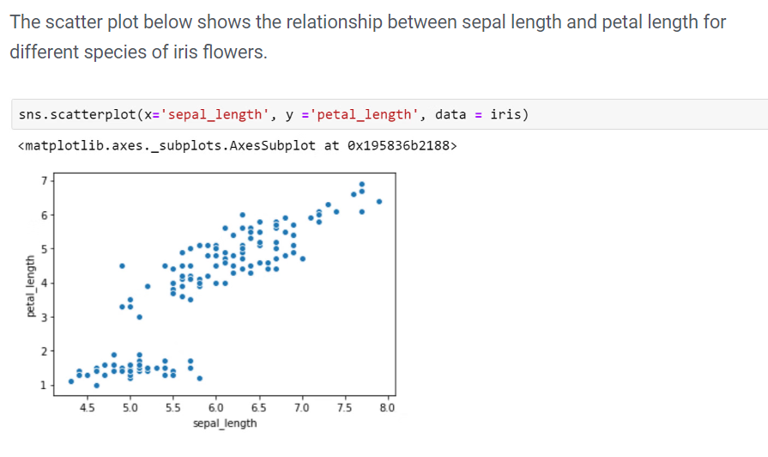

Slide 25
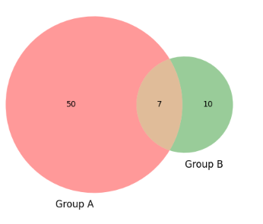
Venn Diagrams in Python
Venn Diagrams are useful for illustrating relations between two or more groups.
pip install matplotlib-venn
# import modules
from matplotlib_venn import venn2
from matplotlib import pyplot as plt
# depict venn diagram
venn2(subsets = (50, 10, 7), set_labels = ('Group A', 'Group B'))
plt.show()

Slide 26
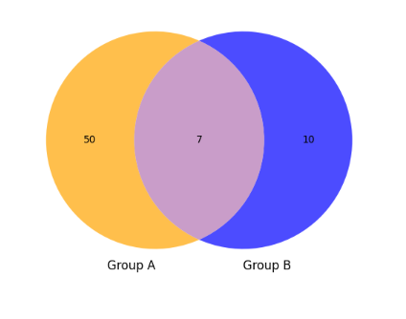
Example:
# import modules
from matplotlib_venn import venn2_unweighted
from matplotlib import pyplot as plt
# depict venn diagram
venn2_unweighted(subsets = (50, 10, 7),
set_labels = ('Group A',
'Group B'),
set_colors=("orange",
"blue"),alpha=0.7)
plt.show()

